Slide 1
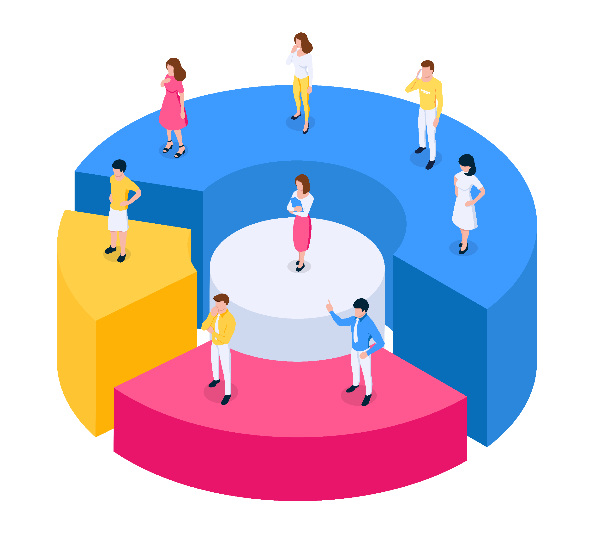
Customer Segmentation Using K-Means Based on RFM Model
Exploretory data analysis
Data cleaning
Data enrichment (RFM Model, etc)
01
02
Running K-Mean clustering
03
Analyze the Clusters, Label, and Interpret the Segments

Slide 2
Table of contents
Customer Segmentation Using K-Means Based on RFM Model
01
Introduction
Overview & key objectives
About Dataset
04
Exploratory data analysis
Transaction Overview
Customer Behaviors
07
Clustering Segmentation
The final data for clustering
K-Means Clustering
Determine numbers of clusters
Clustering Evaluation
02
Data cleaning
Drop unnecessary column
Check for missing values and duplicates
Change data type
05
RFM Model
Calculate RFM
Detect Outliers Using Isolation Forest
08
Cluster Analysis
Cluster Analysis and Profiling
Key characteristics of different customer clusters
Outliers Group Analysis
Our Target
03
Data enrichment
Date attributes
Number of Days between Transactions
Monthly Spending
06
Data Processing
Correlation Analysis
Features Scaling
Principal Component Analysis (PCA)

Slide 3
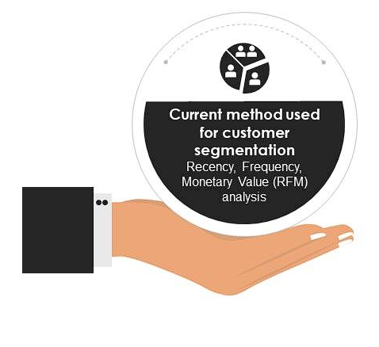





01
Introduction
Overview and key objectives of the report
From a marketing point of view, the reason to segment is the simple answer that not everyone is alike, not all customers are the same. One size does not fit all
Customers in target market
Customers segmentation
‘homogeneous within and heterogeneous between’.
Describing the portrait of the customers, analyzing their overall behavior.
Segmenting customers into distinct groups based on their Recency, Frequency, and Monetary value.
Interpret the characteristics of each segment.
Benefits
Tailored marketing campaigns for
each segment
Specific engagement and spending patterns
Identify high-value customers

Slide 4
01
About Dataset
Historical transaction data
Variable
Data type
Range
Description
From
01/10/2021
to
09/01/2023
BillID
Channel
OrderFrom
TransactionDate
SalesAmount
CustomerID
CustomerGender
CustomerStatus
Province
Numerical
Category
Category
Datetime
Numerical
Numerical
Category
Category
Category
Integer
take away, delivery, dine in
call center, store, website, app
dd/mm/yyyy
Float
Integer
male, female, unknown
Yes/ No
Hanoi, Ho Chi Minh City Northern Provinces, Southern Provinces
The unique of the order
The channel through which the order was consumed
The location through which the order was made
The date of the order
The amount customer paid for the order
The unique ID of the customer
The gender of the customer
Whether a voucher was used for the order
The general location of where the orders was made
Time range
Num. of transactions
1,048,575
unique transactions
Num. of customers
583,642
unique customers

Slide 5
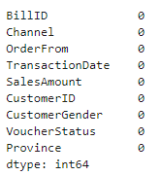
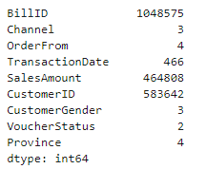
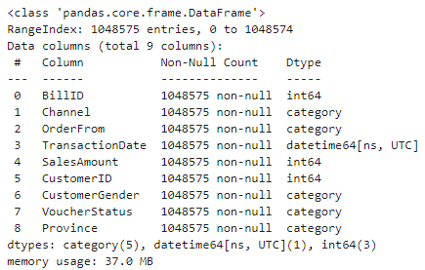
02
Data Cleaning
Drop unnecessary column
Check for missing values
Check for duplicates
Change data types
Unnamed: 0
Num. of unique values in each variables
Conclusion:
There are no missing values.
Each transaction has a unique bill ID, ensuring that the data contains no duplicates..

Slide 6
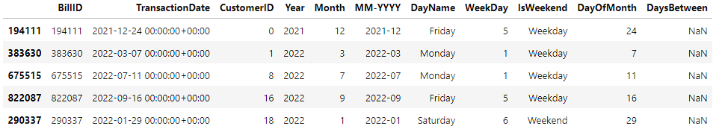
03
Data Enrichment
Beside the attributes of the dataset, there are some additional features that should be created to enrich the data and help us understand more about our customers.
Attributes | Data Type | Range | Description
Year | Numerical | Integer | The year of transaction
Month | Numerical | [1,12] | The month of transaction
MM-YYYY | Category | MM-YYYY | Represents the month and year in the format MM-YYYY
DayName | Category | Monday, Tuesday, etc | The name of the day of the week
WeekDay | Numerical | [1,7] | Represents the day of the week as a numerical value. (1 for Monday, 7 for Sunday).
IsWeekend | Category | (1,0) | A binary indicator (1 for weekend, 0 for weekday)
DayOfMonth | Numerical | [1,30] | The day of the month (1-31)
DaysBetween | Numerical | Integer | The number of days between consecutive customer purchases. NaN is returned when customers do not make repeat purchases.

Slide 7
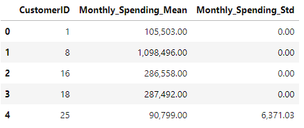
03
Data Enrichment
Insights from Monthly Spending
Standard Deviation
Data type: Numerical
Description: The average amount a customer spends per month.
Monthly_Spending_Mean
Monthly_Spending_Std
Data type: Numerical
Description: The standard deviation of a customer’s monthly spending, showing the variability of spending across months.
Low standard deviations
Consistent spending patterns month over month are less likely to be influenced by seasonal factors, promotions, or other external variables.
Design loyalty programs that reward consistent spending behavior for customers with low standard deviations."
High standard deviations
More variable spending habits, greater sensitivity to external factors, or potential changes in preferences.
Provide customized promotions to incentivize customers to make repeat purchases and minimize fluctuations in their spending.

Slide 8
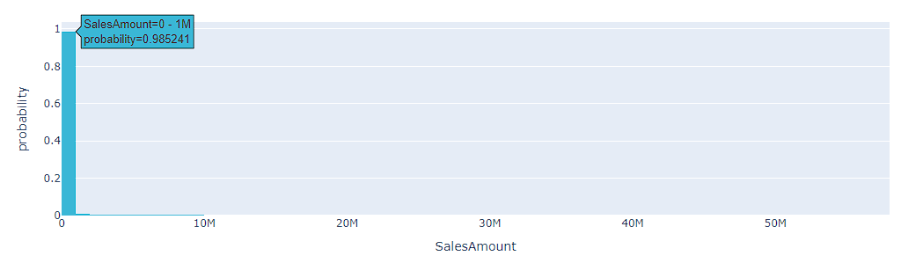
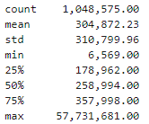
04
Transaction Overview
SalesAmount Distribution
Summary of statistics
count
a long right tail
Right-Skewed
Occasional purchasing: The majority of transactions (98%) are below 1 million; most customers make relatively small purchases.
Specific needs: Transactions exceeding 10M-50M+ suggest a small number of very large transactions, (corporate purchases, bulk orders, or special events)
Insights

Slide 9
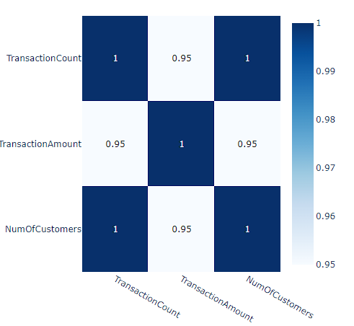
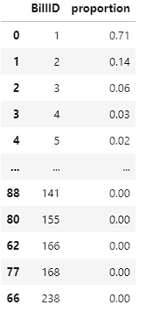
04
Transaction Overview
Correlation Coefficient
% of repeat transaction
High churn rate & Competitive Pressure
Transaction Count
Only 29% of customers make repeat purchases more than once.
Transaction Amount
Many customers do not return after their initial purchase.
Num. of Customers
The industry has high competition, customers may be more likely to switch brands
Transaction Count
Transaction Count
Num. of Customers
More customers typically lead to higher sales and, consequently, a higher transaction amount.

Slide 10
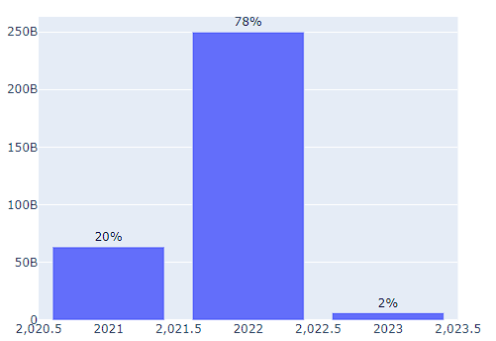
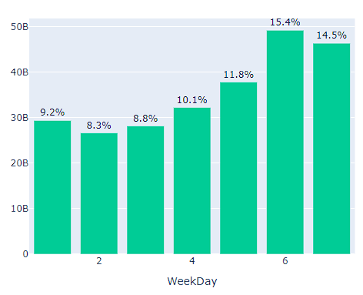
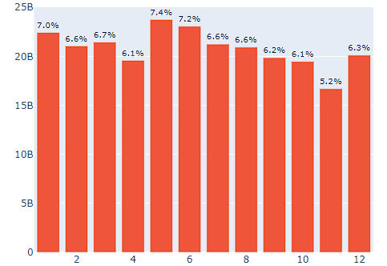
04
Customer Behaviors
Year
Day of Week
Month
Dataset does not include a complete month in the whole three years, we will focus on transactions in 2022 to understand customer behavior over the year and avoid bias
Weekend Purchasing Behavior
Customers prefer to order pizza for social gatherings, family meals, or leisure activities.
Seasonal Demand
Specific seasons, holidays, or events that drive increased consumer spending on pizza.
These months include significant holidays and a spike in transaction amounts
January (Lunar New Year)
May (International Labour Day)
June (Summer holiday).

Slide 11
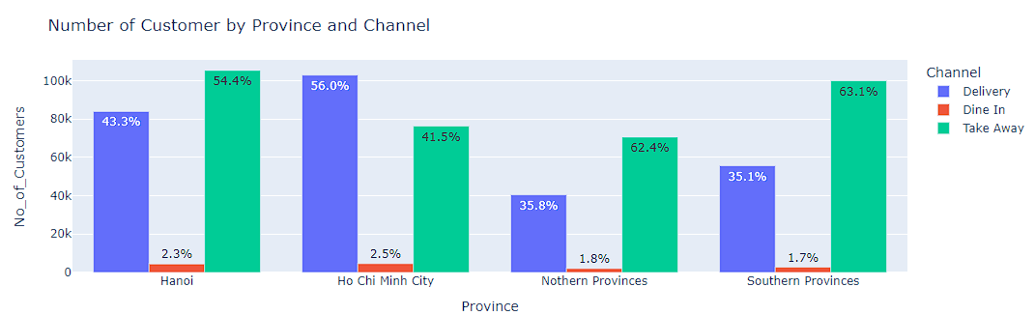
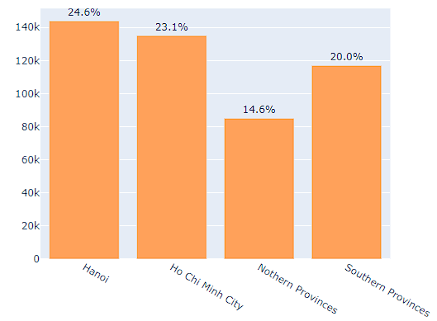
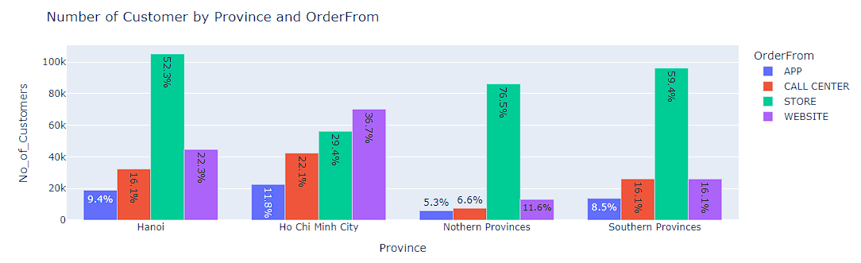
04
Customer Behaviors
Description | Ha Noi | Ho Chi Minh | Northern | Southern
Prefer order from | Take-away (>54%) | Delivery (56%) | Take-away (>62%) | Take-away (>63%)
Channel based | Traditional | Technology | Traditional | Technology
Voucher applied | 12 % | 15,1 % | 6,4 % | 8,6 %

Slide 12
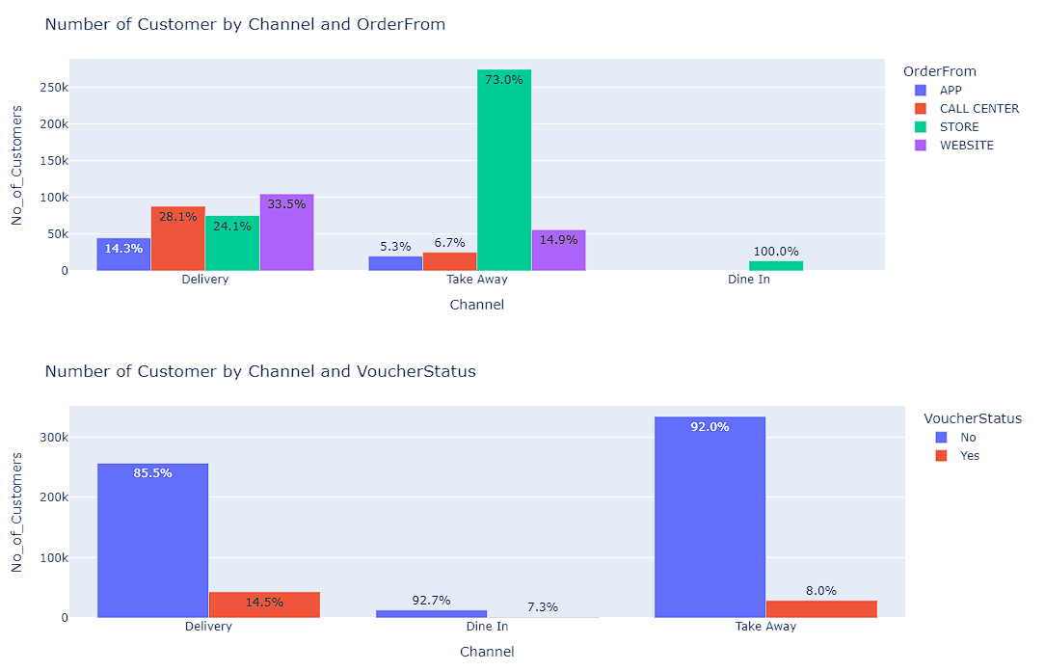
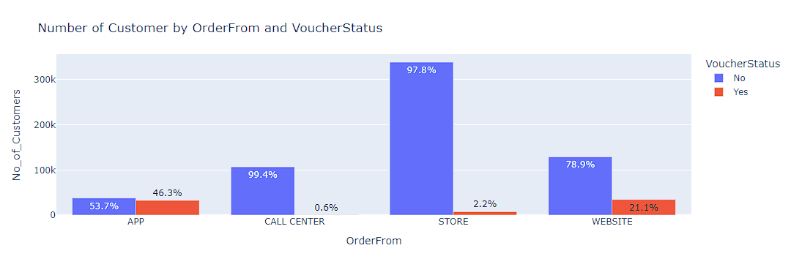
04
Customer Behaviors
Delivery Flexibility
Delivery options flexibility is appreciated by customers, as convenience significantly influences purchasing decisions.
Take-Away Preference
Customers who make in-store purchases primarily opt for take-away, suggesting that they intend to consume the products immediately.
Digital Preference (App and Website Usage
The convenience of applying vouchers during the online ordering process or potential incentives offered for delivery orders may influence voucher usage patterns

Slide 13
05
RFM Model
RFM METRICS
RECENCY
FREQUENCY
MONETARY
How recently a customer has made a purchase
E.g. Time since last order
How often a customer makes a purchase
E.g. Total number of transaction
How much money a customer spends on purchases
E.g. Total transactions value
By analyzing the RFM model, businesses can gain a deeper understanding of customer behavior, identify high-value segments, and optimize marketing and retention strategies to drive growth and profitability.

Slide 14
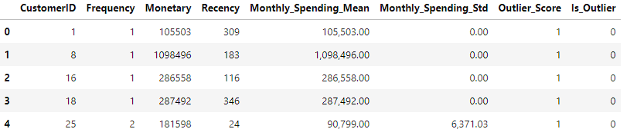
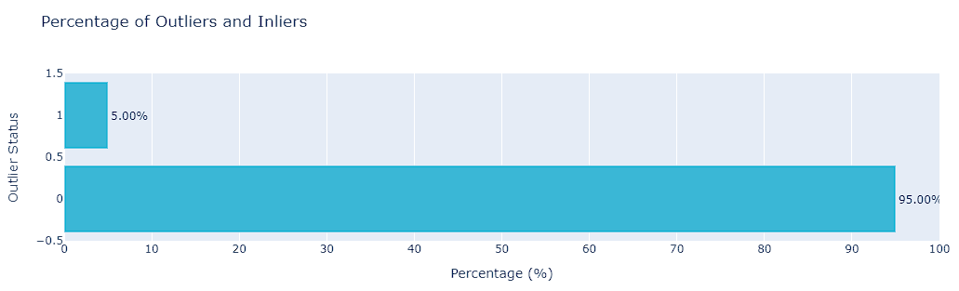
05
Handling Outliers
ISOLATIONFOREST
An anomaly detection algorithm that identifies outliers by isolating data points in a dataset. It works on the principle that outliers are "few and different" from the rest of the data points.
contamination=0.05: approximately 5% of the data is expected to be outliers.
Outlier_Score: a score of 1 for inliers (normal data points) and -1 for outliers (anomalous data points).
About 5% of the customers have been identified as outliers in dataset. This percentage seems to be a reasonable proportion, not too high to lose a significant amount of data, and not too low to retain potentially noisy data points.
After detecting outliers, create a new dataframe containing RFM features without the outliers.

Slide 15
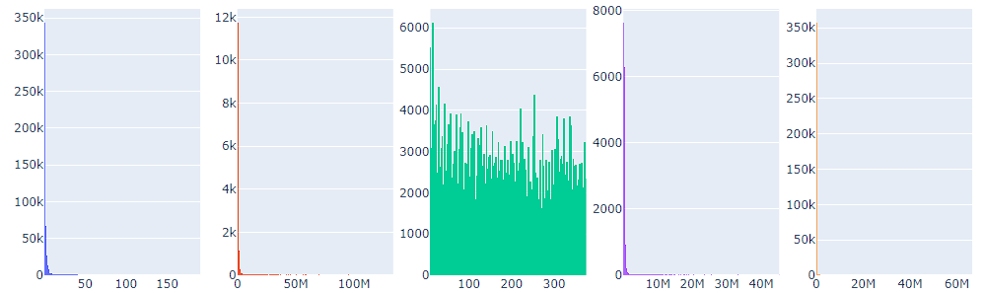
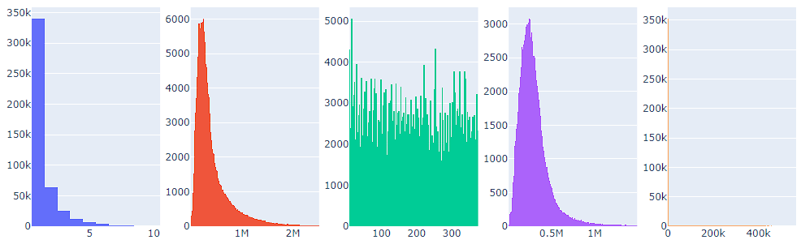
05
Handling Outliers
Frequency
Monetary
Recency
Monthly_Spending_Mean
Monthly_Spending_Std
With outliers
Without outliers

Slide 16

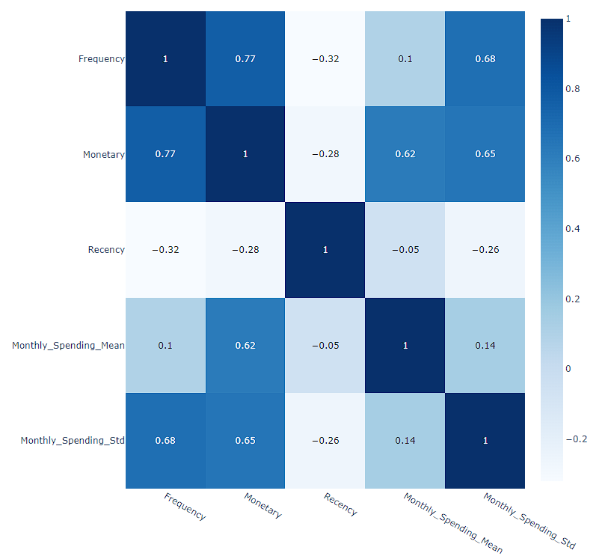







06
Correlation analysis
Statistical technique used to measure the strength of relationship between different variables
High correlations
Heatmap for the customer_RFM
Who are high-value customers ?
High-frequency customers
Higher fluctuations in monthly spending
Consistently spend more in a given month
High-frequency customers with inconsistent spending habits
Impact of multicollinearity
High correlations indicate that these variables move closely together, implying a degree of multicollinearity.
Treat multicollinearity by using dimensionality reduction techniques such as PCA to create uncorrelated variables for more stable clusters in the KMeans clustering process

Slide 17
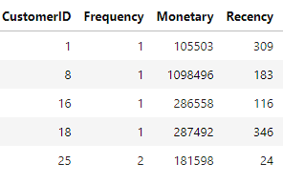
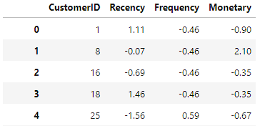
06
Feature Scaling
Standardization is a scaling technique wherein it makes the data scale-free by converting the statistical distribution of the data into
mean = 0 (zero) & standard deviation = 1
Impact of features are not on a similar scale
K-means Clustering
Before Scaling
The clustering algorithm heavily depends on the concept of 'distance' between data points.
Data points with larger values can have a disproportionate influence on the clustering outcome, potentially leading to incorrect groupings.
The data obtained contain features of various dimensions and scales
PCA
PCA aims to find the directions where the data varies the most.
Data points with larger values might dominate these components, not accurately reflecting the underlying patterns in the data.
After Scaling

Slide 18
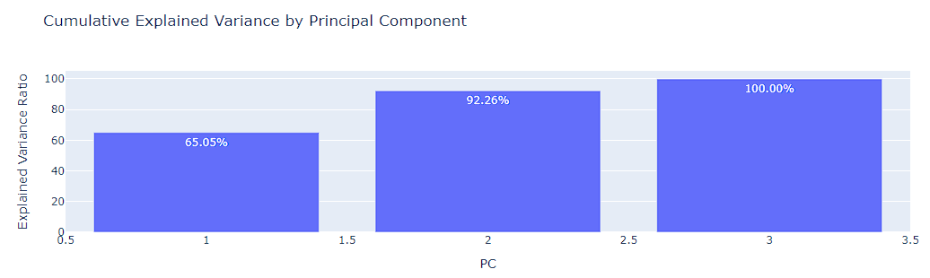
06
Dimensionality Reduction
Key metrics
Explained_variance_ratio
Cumulative explained variance
Principal Component Analysis
A dimensionality reduction technique used to transform a large set of correlated variables into a smaller set of uncorrelated variables
How much information (variance) each principal component capture from the original dataset
Total variance explained by a subset of the principal components
Goal of PCA is to reduce the complexity of the dataset while retaining as much variability (information) as possible
It does this by identifying the directions (principal components) along which the variation in the data is maximized.
Assess the effectiveness of dimensionality reduction
The first two components together explain ~ 92% of the variance.
This is a significant portion of the total variance while also reducing the dimensionality of the dataset and retaining enough information to effectively identify distinct customer groups for customer segmentation.

Slide 19
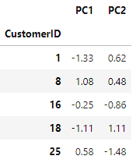
07
The final data for clustering
Detect outliers
Scaling
PCA
Train model

Slide 20
07
K-Means
Unsupervised learning technique that groups the unlabeled dataset into different clusters
K-means clustering
The goal of clustering is grouping of things based on how similar and different they are to one another
K is the number of clusters and the centroids are the mean of the clusters
K-means clustering process for customer segmentation
Determine number of clusters
Select initial centroids
Map each data point into closest cluster
Update mean value of each cluster
Repeat step 3-4
Identify optimum number of clusters that best represent these different customer segments
Select centroids that represent different demographic groups or initial guesses based on customer segments past knowledge
Calculate similarity of each customer’s spending behavior across multiple dimension to assign clusters
Mean values of the data points in each cluster are calculated to get new centroids
Repeat step 3-4 until all centroids are not changed

Slide 21
08
Determine number of clusters
2
4
1
How tightly the data points are packed within each cluster.
3
How intra-cluster compactness and inter-cluster separation.
Balance between having too few clusters (underfitting) and too many clusters (overfitting).
How well clusters are separated.
2
3
Inertia Score
Davies-Bouldin Index
1
4
Elbow Method
Methods for determining ideal number of cluster
Calinski-Harabasz Index

Slide 22

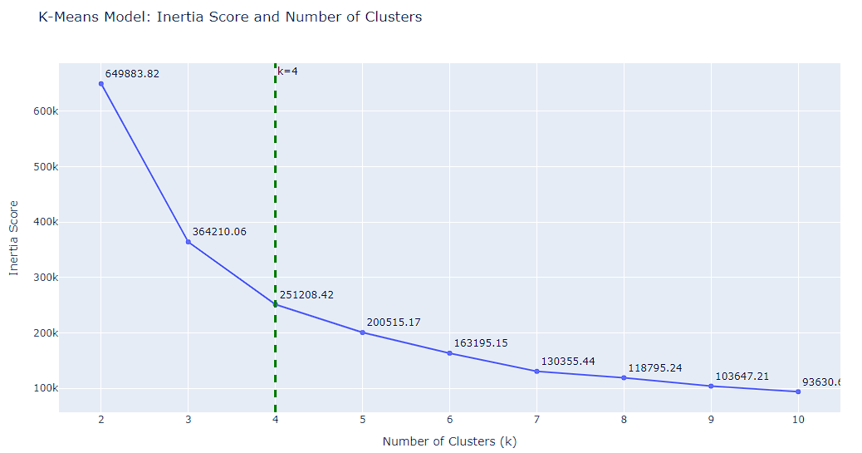
07
Elbow method to determine ideal number of clusters
Methods to find Elbow point
Look for the "elbow" point in the plot
A lower inertia score means the data points are closer to their centroids, indicating better clustering.
The "elbow" represents the point where the inertia starts to decrease more slowly.
Elbow point
KneeLocator
A tool from the kneed library in Python that helps to find the "elbow" or "knee" point in a curve.
Adding more clusters beyond this point doesn’t result in much improvement in cluster quality.
Why is the Elbow Method used ?
Inertia decreases as K increases (since more clusters will naturally reduce distances), so Inertia is not always the best measure to select K.

Slide 23
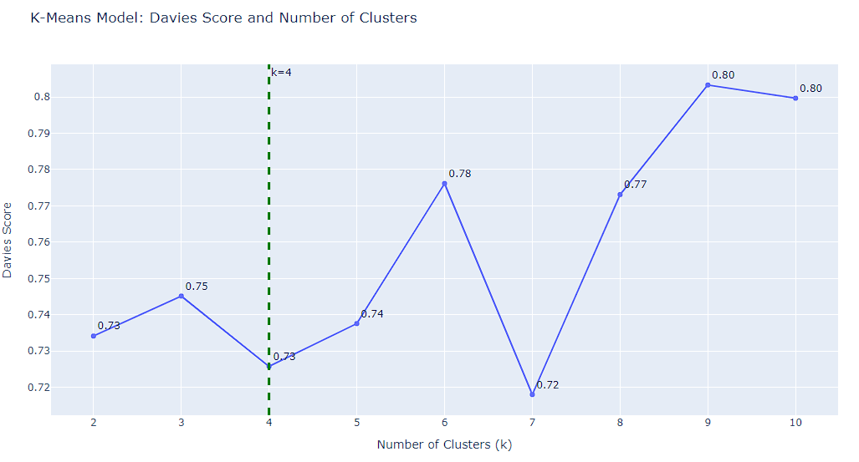
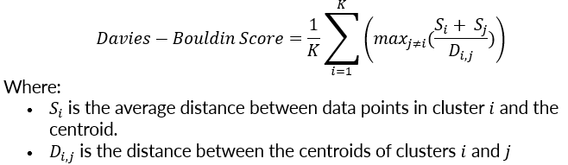
07
Davies-Bouldin score to compares the similarity between clusters
Elbow point
The lower the Davies-Bouldin score, the better the clustering, as it indicates that clusters are compact and well-separated from each other.
A higher score indicates more overlap and less distinction between clusters.

Slide 24
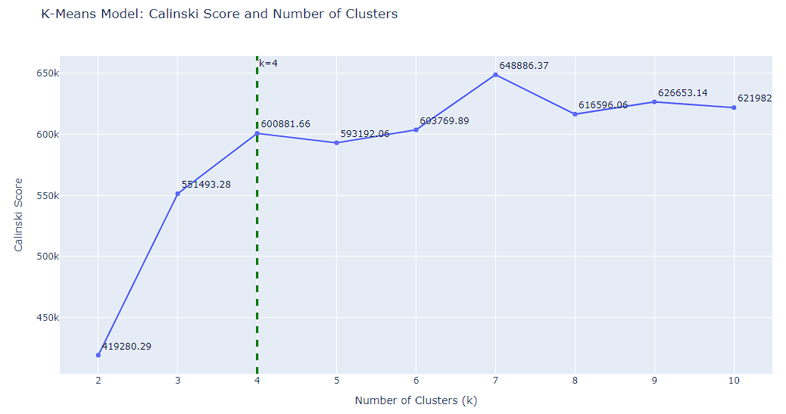

07
Calinski-Harabasz Index
Elbow point
The higher the Calinski-Harabasz score, the better the defined clusters (i.e., clusters are compact and well-separated).
It's a good measure to determine the quality of the clustering structure in terms of both intra-cluster compactness and inter-cluster separation.

Slide 25
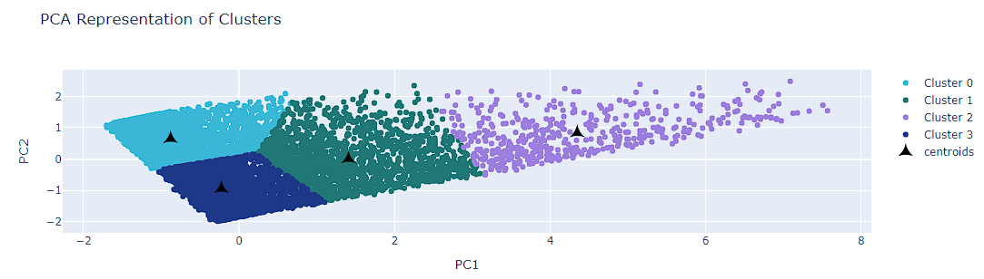
07
Apply K-means clustering algorithm to segment customers
The visualization below displays 5 clusters after segmentation. It uses the top 2 principal components (PCs) which capture the most variance in the data to create a 2D visualization. This allows us to visually inspect the quality of separation and cohesion of clusters to some extent.

Slide 26
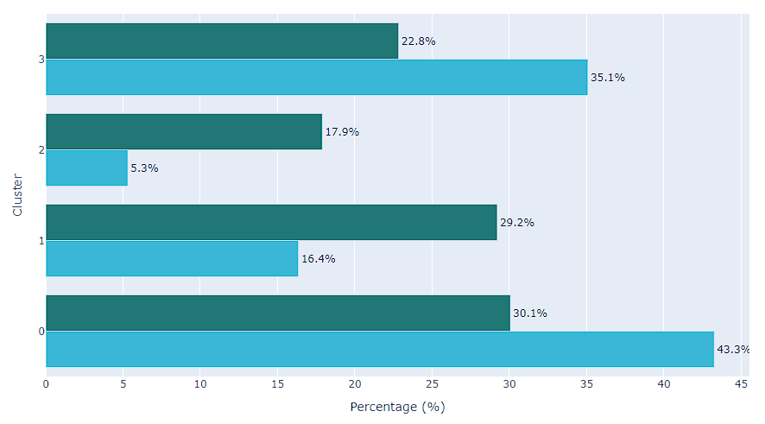
08
Cluster Distribution Visualization
Distribution of Users and GMV Across Clusters
Customer segmentation is valuable for identifying distinct customer groups with varying characteristics and value.
Cluster 0: Despite making up nearly half of the customer base, contribution to GMV is significantly lower than their proportion of the total population.
Cluster 1: a relatively small number of customers but a disproportionately high contribution to GMV.
Cluster 2: smallest cluster but contributes ~18% to GMV, meaning their individual spending is high.
GMV Distribution
Customer Distribution
Cluster 3: moderately large group, contributes to the GMV somewhat proportionally to their size, but still less than expected.

Slide 27
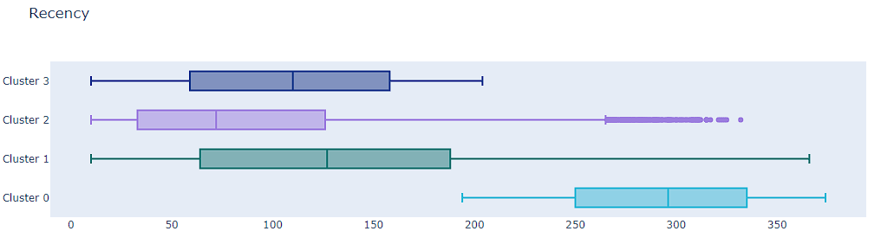
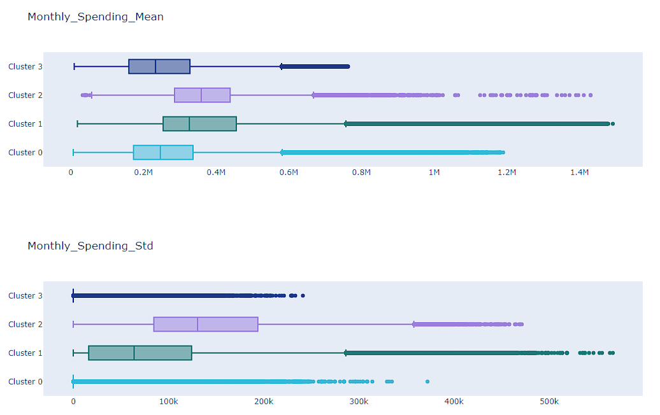
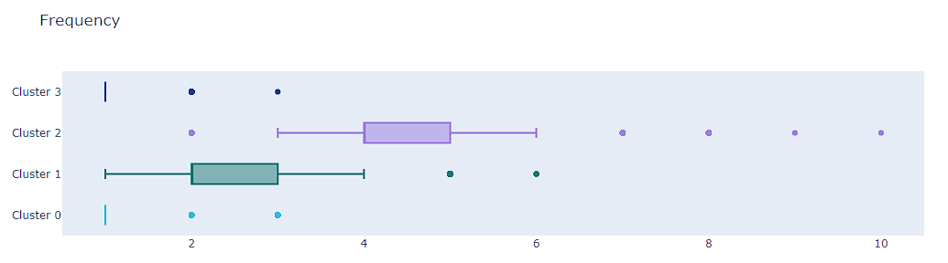
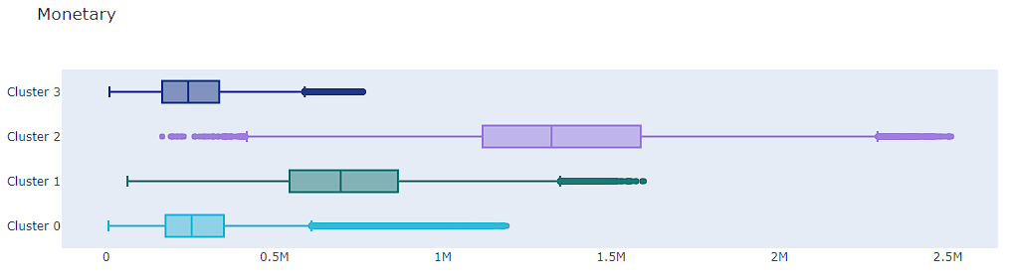
08
Boxplots of each feature by clusters
Each cluster contains a different range of individual features that help to differentiate one from the others.

Slide 28
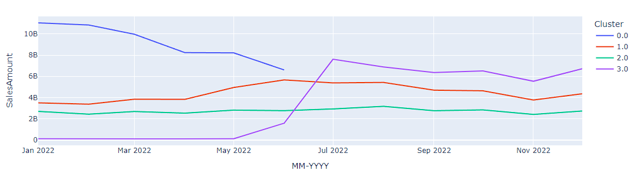
08
Seasonal Factors
SALESAMOUNTS BY MONTH OF EACH CLUSTER
Summer Holiday
National Day
Christmas
Labour Day
Haloween
Seasonal influence: There is a peak of monetary activity in the months that contain special days for most clusters.
Churned point: Transitioning between seasons influences dining behaviors as families settle back into routines.
Insights

Slide 29
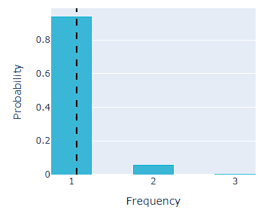
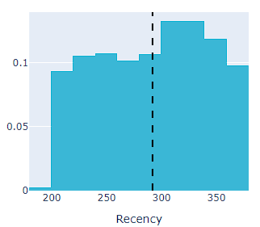
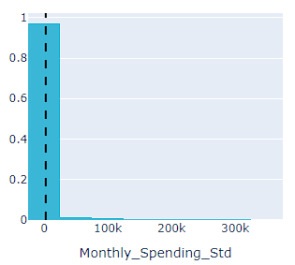



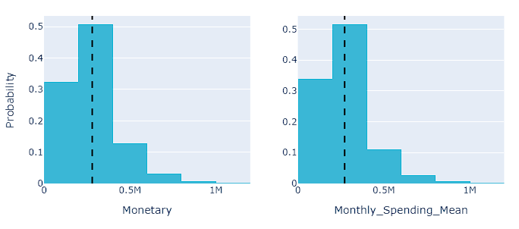
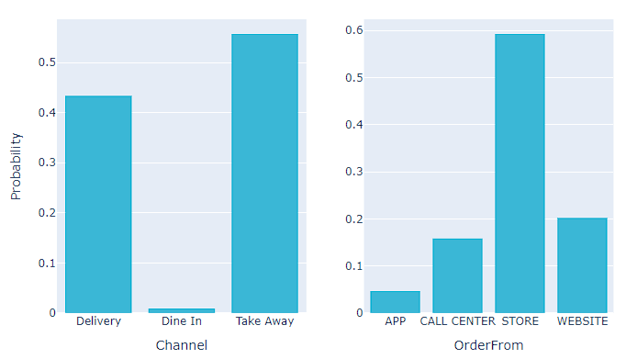


08
Cluster Profilings
Cluster 0
At-Risk Churners
Limited engagement and infrequent return visits: Customers who made one purchase, and are unlikely to return.
High Churn Rate: The long recency (6months) and lack of repeat purchases
93% of customers made only one purchase and did not make any repeat purchases.
Customers have not made a purchase in over 194 days
The consistency in customer behavior is mostly due to making a single purchase and then leaving.
Low-spending behavior: Despite having the largest number of customers, their spending patterns are consistently low.
Their consistent spending may be due to the fact that most of them do not return.
Traditional Ordering Preferences: prefer to order in-store or for takeaway, with fewer using app-based channels.
82% of the monetary value falls below 0.4M
Customers typically place orders in-store for takeout. They can also order through the website or call center, which are traditional methods.

Slide 30
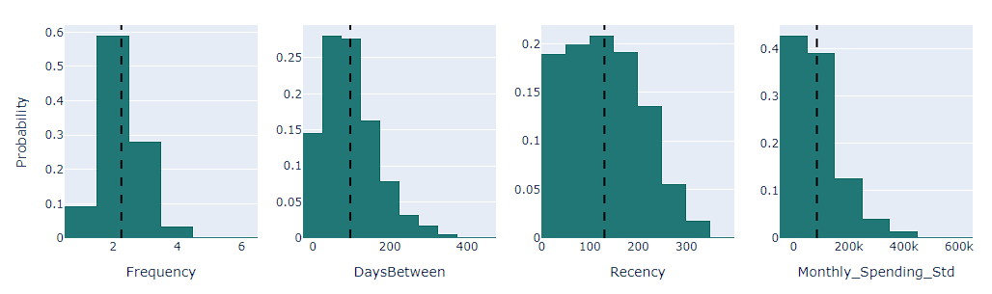
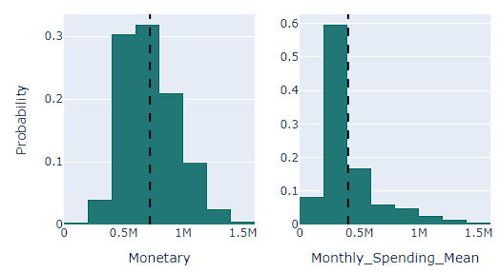
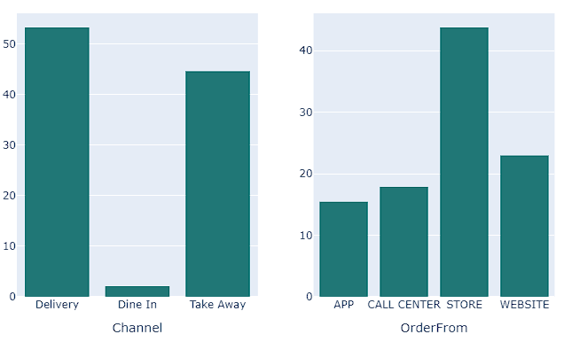
08
Cluster Profilings
Cluster 1
Steady Average Spender
Moderately Engaged Repeat Buyers: return every few months and high frequency of repeat purchases
A need to re-engage a small portion of customers to prevent complete churn, although most of customers have been active recently
91% of customers make repeat purchases with the time between purchases generally falling below 175 days
The average recency is about 130 days since their last purchase
58% of customers experience fluctuations in monthly spending, with variations greater than 50,000.
Contributes nearly the most to the total GMV (29.2%, while the highest contribution is 30.1%).
Strongly influenced by seasonal factors, especially during the summer holiday.
Flexibility : use various ordering methods like web, app, and call center, but store and delivery are preferred.
Their spending ranges from 0.073M to 1.6M, with 81% of customers spending between 0.4M and 1M. The monthly spending mean is mostly around 0.2M to 0.4M
53% of orders come from store and delivery channels, followed by take-away (44.6%).

Slide 31
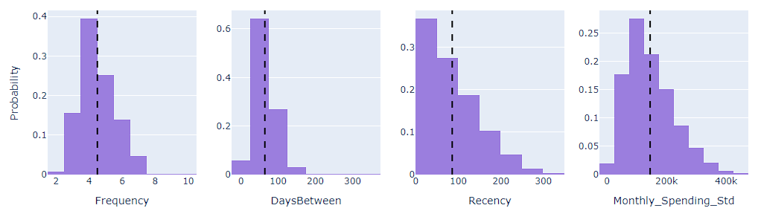
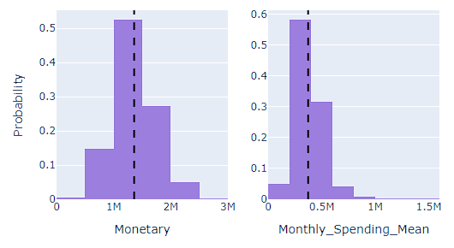
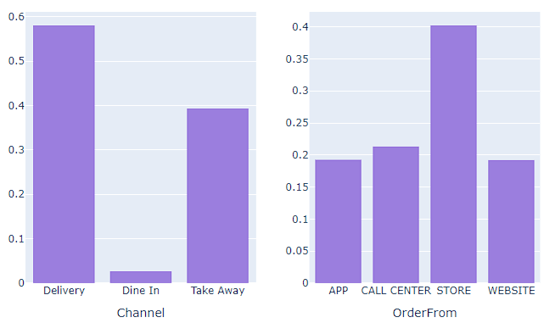
08
Cluster Profilings
Cluster 2
Loyal High Spenders
High Engaged: frequent shoppers who have made multiple purchases within a short timeframe.
Fluctuating Monthly Behavior: Their spending behavior varies from month to month, reflecting flexibility in their purchasing habits.
Customers have recently made purchases, with most occurring within the 3 months (90 days). The time between purchases generally ranges from 25 to 120 days.
The average recency is about 85 days since their last purchase
High fluctuations in monthly spending, with variations ranging from 25K to 225K.
High-value customers: The lowest number of customers (5.3%) contributes to 17.9% of the total revenue.
Gradually increasing over time, unaffected by seasonal factors.
Multi-Channel Adoption: Maintaining a balance between in-person and digital interactions.
Wide range spending from 100K to 2.5M, with the majority spending between 0.5M and 2M. Their monthly spending average is mostly between 0.2M and 0.6M, with some reaching to 1.5M.
40% of orders come from in-store and delivery, while the remaining methods (web, app, call center) are distributed almost equally.

Slide 32



08
Cluster Profilings
Cluster 3
High Potential NewComers
Newly Infrequent Small-Spending Shoppers, indicating customers are considering other brands
Expect a significant increase in monetary funds starting from July 2022.
94% of customers made only one purchase
It is likely that newcomers have a short recency.
97% of customers exhibit consistent monthly spending
Moderate spending habits, but a large number of customers, contribute 22.8% to GMV
Strongly influenced by seasonal factors, especially during the summer holiday
Physical interactions over digital ones - a preference for immediate consumption
The spending ranges below 860K, with 78% of spending between 0.1M to 0.4M, reinforcing the small-spender nature of this group.
Most orders come from store and takeaway channels.

Slide 33
08
Key characteristics of different customer clusters
Steady Average Spenders
Moderate frequency, steady but not high monetary value
At-Risk Churners
Flexibility in technology-based and traditional ordering & channels.
Rarely purchase, high recency, high spending in the past.
Steady GMV contribution, stable purchasing pattern.
Traditional ordering preference
1
Keep them engaged with periodic rewards or exclusive content to maintain loyalty.
43,3% of the customer base , contribute 30,1% to GMV.
Re-engagement strategies such as special offers or personalized communication.
0
2
3
Loyal High Spenders
Very high frequency and monetary, low recency
Flexibility in technology-based and traditional ordering & channels.
High Potential NewComers
5,3% of the customer base , contribute 17,9% to GMV.
Low frequency, Medium recency, moderate spending.
Prioritize retention with exclusive offers or loyalty rewards.
Traditional ordering preference
35,1% of the customer base , contribute 22,8% to GMV.
Build long-term loyalty through welcome offers and personalized onboarding.

Slide 34




08
Analyze customers in outliers
Outliers Group
Distribution: 5% of the total customers contribute 26.5% to the revenue.
Low Spend, High Frequency: regular buyers who make smaller, likely everyday purchases.
High Spend, Low Frequency: corporate buyers, event organizers, or simply those who prefer bulk orders.
Inconsistent Monthly Spending: Purchasing decisions can be influenced by seasonal requirements, special events, or occasional promotions.
Multi-Channel Adoption: Maintaining a balance between in-person and digital interactions.

Slide 35

08
Our Target
Meet specific needs
Customized programs designed to address specific seasonal and individual requirements.
Re-engage customers
Offering incentives for high-churn-rate customers, such as comeback vouchers and personalized events.
Delivery channel
Develop delivery channels that meet current market expectations.
Up-sale & Loyalty points
Up-sale for loyal customers. Establishing a loyalty program to earn points that can be redeemed within a limited time.
Channel Promotion
Develop app and website channels to enhance customer engagement.

Slide 36



Thanks for watching!
Contact number
+84 979 640 199
Email address
ngochuyenvu165@gmail.com

Slide 37

08
07
R
F
M
Time since the customer’s most recent transaction
Purple: #9B7EDE
Bold blue: #1E3888
Green: #87D68D
Insights

